Slide 1
Brief Introduction to Molecular Simulation
Part of PHY627A course

Slide 2
WHY COMPUTER SIMULATIONS?
OBJECTS
Molecular Systems
TOOLS
GOALS
Models
Make predictions
Physical Laws.
Quantum Mechanics
Statistical Mechanics
Mathematical Models
Compute Physical properties – compare with experiments – Explain Experimental results – Guide Experimentalists
Where there are no available experimental data
Where it is difficult or impossible to get experimental data
If experiments are expensive
Input parameters for theoretical model
Computer simulations allow us to describe macroscopic observations with the use of microscopic description of matter.

Slide 3
Computational Tools
Band structure (electrical properties)
Magnetization
Chemical reactions
Enzyme catalysis
And so on ……
Degree of freedom: electronic, nuclear
Quantum Mechanics (QM)
Schrödinger equation
MORE accurate
EXPENSIVE, small system
Molecular Mechanics (MM)
Newton equation (classical)
LESS accurate
FAST, big system
Polymer/protein folding
Biomolecular association
Partitioning between solvents
Membrane/micelle formation
And so on …..
Degree of freedom: atomic
Quantum/Classical (QM/MM)
Hybrid simulations
QM
MM

Slide 4
Time and Length Scale
Length scale
Time scale

Slide 5
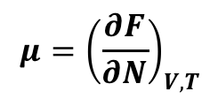
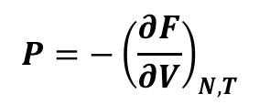
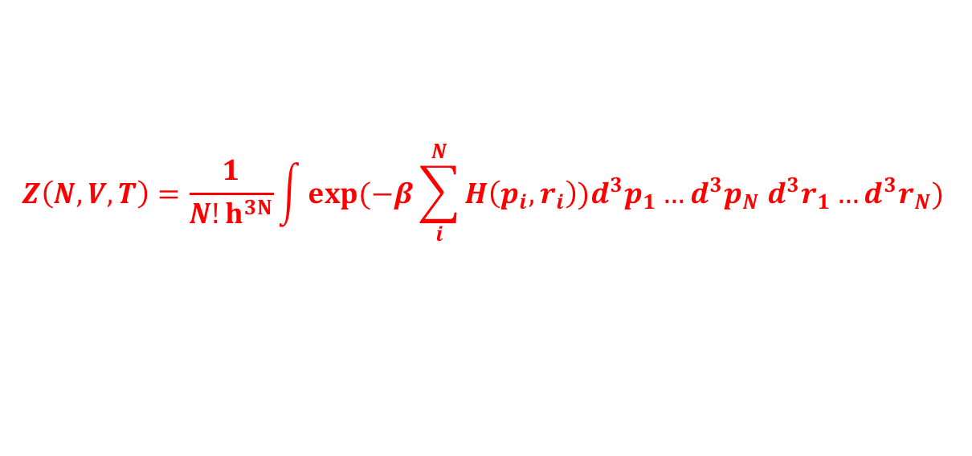
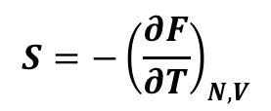
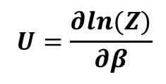
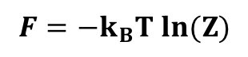
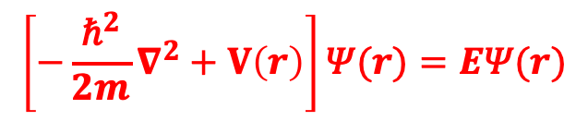
Computational Tools: Basic Theory
Quantum Mechanics
$$V\left(r\right)−potential,\text{Ψ}−Wave function, E −Eigenvalues$$
$$\left[−\frac{{\text{ℏ}}^{2}}{2m}∇^{2}+V\left(r\right)\right]\text{Ψ}(r)=E\text{Ψ}(r)$$
Solve Schrödinger Equation: get wave function, Eigenvalues, Density, Energy, Stress, Force.
Statistical Mechanics
N particle system, $H\left(p,r\right)$ – Hamiltonian, $p$ – momentum, $r$– position
$$Z\left(N,V,T\right)=\frac{1}{N!h^{3N}}\int{exp⁡(−β\sum_{i}^{N}{H\left(p_{i},r_{i}\right))d^{3}p_{1}…d^{3}p_{N} d^{3}r_{1}}}…d^{3}r_{N})$$
partition function:
$$F={−k}_{B}T ln(Z)$$
$$U=\frac{∂ln(Z)}{∂β}$$
$$S=−{\left(\frac{∂F}{∂T}\right)}_{N,V}$$
$$P=−{\left(\frac{∂F}{∂V}\right)}_{N,T}$$
$$μ={\left(\frac{∂F}{∂N}\right)}_{V,T}$$

Slide 6
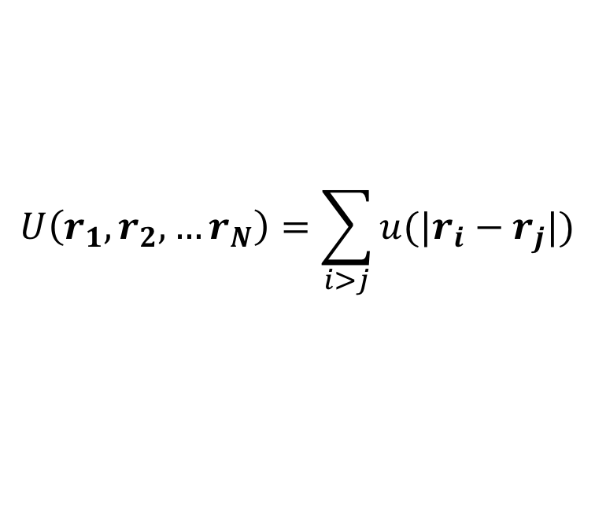
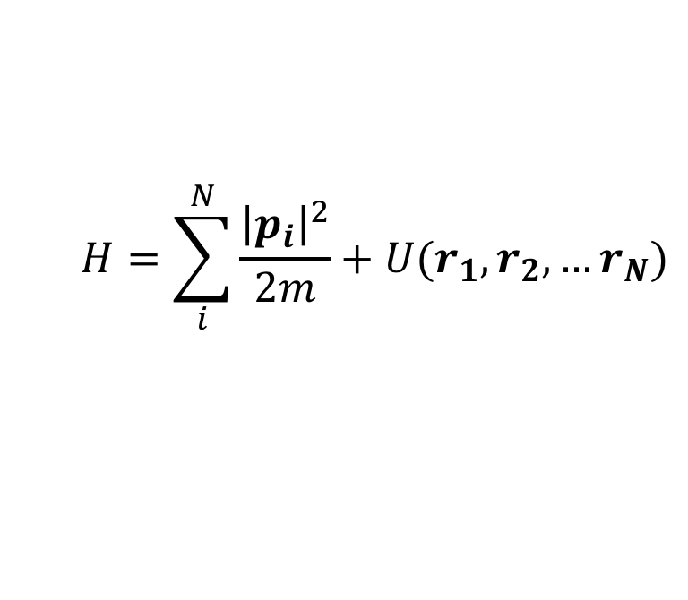
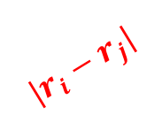
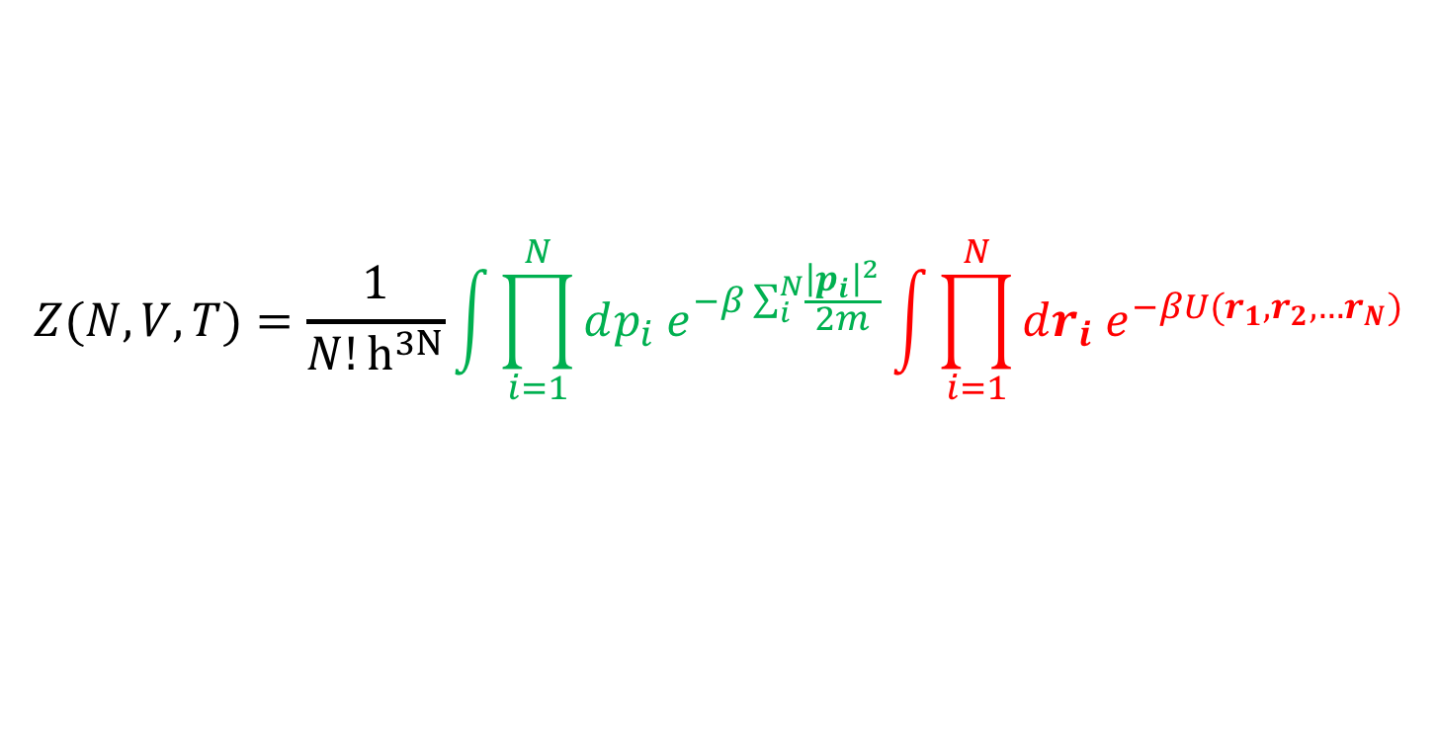
Many Particle Problem in Statistical Mechanics
Collection of N atoms
$$H=\sum_{i}^{N}{\frac{{\left|p_{i}\right|}^{2}}{2m}+U(r_{1},r_{2}, …r_{N})}$$
$$U\left(r_{1},r_{2}, …r_{N}\right)=\sum_{i>j}{u(|r_{i}−r_{j}|)}$$
$$|r_{i}−r_{j}|$$
$$Z(N,V,T)=\frac{1}{N!h^{3N}}\int{\prod_{i=1}^{N}{dp_{i} e^{−β\sum_{i}^{N}{\frac{{\left|p_{i}\right|}^{2}}{2m}}}\int{\prod_{i=1}^{N}{{dr_{i} e}^{−βU(r_{1},r_{2}, …r_{N})}}}}}$$
K.E. contribution
P.E. contribution
Difficult to calculate
Atoms interact among themselves – partition function can not be computed
Approximated methods
Cluster expansion, Mean field approximation, Renormalization group (RG) ……

Slide 7
Potential Energy Surface
https://chem.libretexts.org
Figure Courtesy: Fabien Cailliez

Slide 8
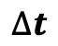
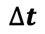
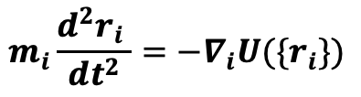
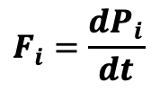
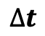
Generating Configurations and Calculating Average Properties
Monte Carlo: generate ‘important’ configurations, accept or reject based on predetermined
criteria, calculate ensemble average
Yes/No
Yes/No
Yes/No
Molecular Dynamics: calculate force based on ‘force field’, obtain time evolution,
calculate time average
$$F_{i}=\frac{dP_{i}}{dt}$$
$$m_{i}\frac{d^{2}r_{i} }{dt^{2}}=−∇_{i}U(\{r_{i}\})$$
$$∆t$$
$$∆t$$
$$∆t$$

Slide 9
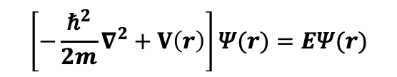
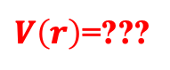
Classical Molecular Dynamics Simulation
$$\left[−\frac{{\text{ℏ}}^{2}}{2m}∇^{2}+V\left(r\right)\right]\text{Ψ}(r)=E\text{Ψ}(r)$$
$V\left(r\right)$=???
For a given intermolecular potential, predict the thermodynamic and transport properties of the system
We assume the interactions
between the particles are known!!
Electronic degrees of freedom are integrated out… But effects are included.
Can we predict the macroscopic properties of (classical) many-body systems – provided intermolecular potential is known?
NEWTON:- YES! Solve $F=ma$gives future time evolution of the System
- Provided initial position, velocity, and interaction of all molecules known.

Slide 10
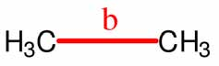
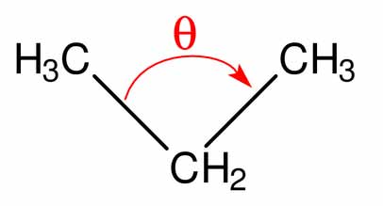
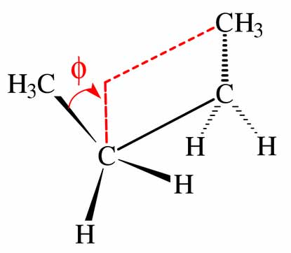
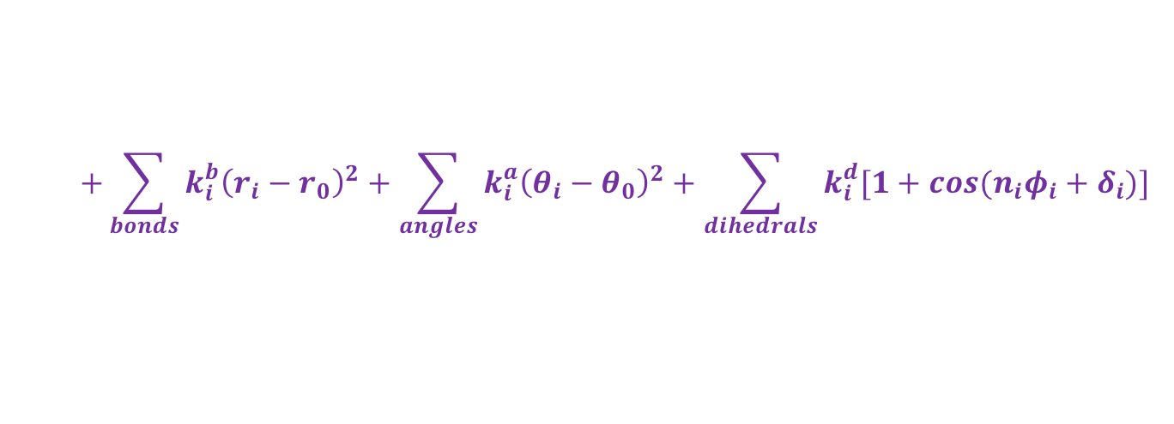
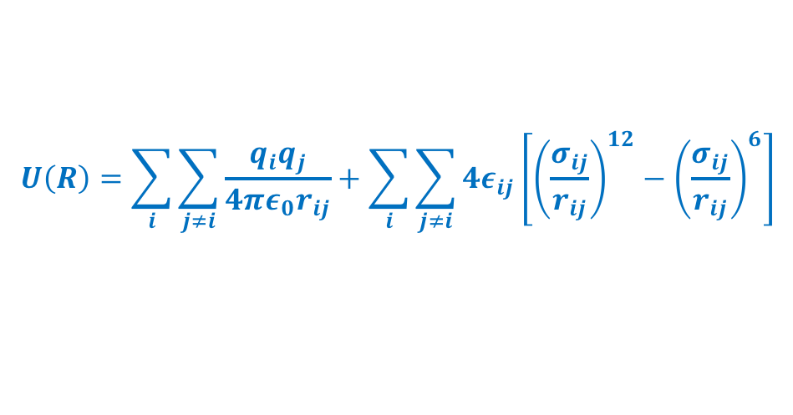
Classical Molecular Dynamics Simulation: Force Field
Electronic degrees of freedom are integrated out… But effects must be included
Intermolecular potential – EMPIRICAL - Parameters PREASSIGNED
nonbonded
Partial charge / net atomic charge / fractional charge
Asymmetric distribution of electrons in chemical bond
$$U\left(R\right)=\sum_{i}{\sum_{j≠i}{\frac{q_{i}q_{j}}{4πε_{0}r_{ij}}+\sum_{i}{\sum_{j≠i}{4ε_{ij}\left[{\left(\frac{σ_{ij}}{r_{ij}}\right)}^{12}−{\left(\frac{σ_{ij}}{r_{ij}}\right)}^{6}\right]}}}}$$
Pauli exclusion
$$+\sum_{bonds}{k_{i}^{b}{\left(r_{i}−r_{0}\right)}^{2}+\sum_{angles}{k_{i}^{a}{\left(θ_{i}−θ_{0}\right)}^{2}+\sum_{dihedrals}{k_{i}^{d}[1+cos⁡(n_{i}φ_{i}+δ_{i})]}}}$$
Dipole induced interaction
bonded
bond
angle
dihedral

Slide 11
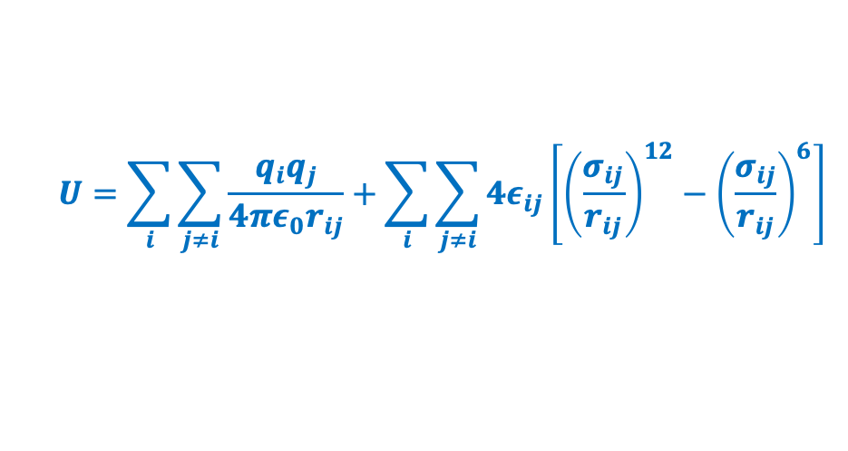
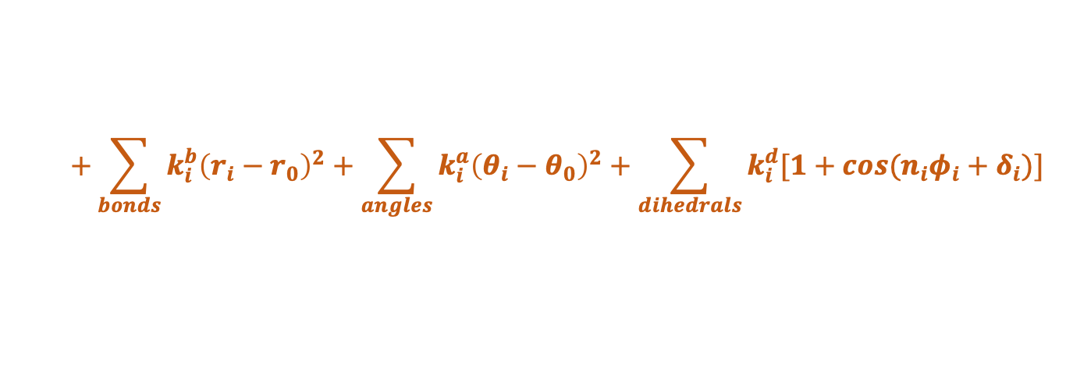
Classical Molecular Dynamics Simulation: Force Field
$$U=\sum_{i}{\sum_{j≠i}{\frac{q_{i}q_{j}}{4πε_{0}r_{ij}}+\sum_{i}{\sum_{j≠i}{4ε_{ij}\left[{\left(\frac{σ_{ij}}{r_{ij}}\right)}^{12}−{\left(\frac{σ_{ij}}{r_{ij}}\right)}^{6}\right]}}}}$$
$$+\sum_{bonds}{k_{i}^{b}{\left(r_{i}−r_{0}\right)}^{2}+\sum_{angles}{k_{i}^{a}{\left(θ_{i}−θ_{0}\right)}^{2}+\sum_{dihedrals}{k_{i}^{d}[1+cos⁡(n_{i}φ_{i}+δ_{i})]}}}$$
water molecules
graphene
Potential functions are not unique
Parameters are determined by fitting experimental data
Accuracy of results depend on accuracy of the forcefield
Longer length (system size) and time scale can be achieved
Particularly suitable for biomolecules
**Not suitable for studying any phenomena that involves
electrons directly where quantum effects are dominating,
Such as Chemical reactions, enzyme catalysis etc.
Adv. Drug Deliv. Rev. (2012), doi:10.1016/j.addr.2012.02.011

Slide 12
Integration Schemes: Criteria
Speed not very important (as force calculations are more time consuming). Accuracy for large time step is more important. Sophisticated algorithm would allow us to use a relatively larger time step
Total energy should remain approximately constant
Stability for long term energy conservation. Higher order algorithms are very good for short time energy conservation, but usually energy drifts at long time. Verlet or Verlet-like algorithms tend moderate short time energy conservation but smaller long-term drift.
Newton’s equations are time reversal so should be the integration algorithms. R(t) R(-t)
If the momenta of all particles are reversed at a given instant, the system should trace back its trajectory
in phase space.
Should be easy to write. And also should be reliable for different potentials, temperature and density ranges.
Frenkel and Smit

Slide 13
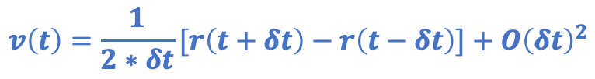
Integration Schemes: Verlet
$$r\left(t+δt\right)=r\left(t\right)+v\left(t\right)∗δt+\frac{1}{2}a\left(t\right)∗{\left(δt\right)}^{2}+b\left(t\right)∗{\left(δt\right)}^{3}+O{\left(δt\right)}^{4}$$
$$r\left(t−δt\right)=r\left(t\right)−v\left(t\right)∗δt+\frac{1}{2}a\left(t\right)∗{\left(δt\right)}^{2}−b\left(t\right)∗{\left(δt\right)}^{3}+O{\left(δt\right)}^{4}$$
$$r\left(t+δt\right)=2∗r\left(t\right)−r(t−δt)+a\left(t\right)∗{\left(δt\right)}^{2}+O{\left(δt\right)}^{4}$$
$$v\left(t\right)=\frac{1}{2∗δt}[r\left(t+δt\right)−r\left(t−δt\right)]+O{\left(δt\right)}^{2}$$

Slide 14
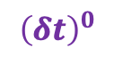
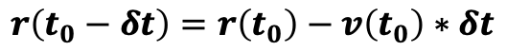
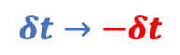
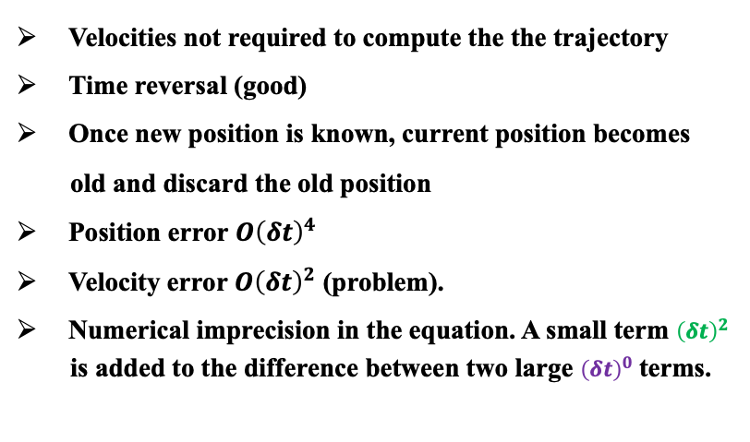
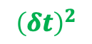
Integration Schemes: Verlet
To start the algorithm
$$r\left(t_{0}−δt\right)=r\left(t_{0}\right)−v\left(t_{0}\right)∗δt$$
Velocities not calculated during integrations, but are used to compute kinetic energy, diffusion constant etc.
Time reversal
$$r\left(t−δt\right)=2∗r\left(t\right)−r(t+δt)+a\left(t\right)∗{\left(δt\right)}^{2}$$
Velocities not required to compute the the trajectory
Time reversal (good)
Once new position is known, current position becomes
old and discard the old position
Position error $O{\left(δt\right)}^{4}$
Velocity error $O{\left(δt\right)}^{2}$ (problem).
Numerical imprecision in the equation. A small term ${\left(δt\right)}^{2}$
is added to the difference between two large ${\left(δt\right)}^{0}$ terms.
$$r\left(t+δt\right)=2∗r\left(t\right)−r(t−δt)+a\left(t\right)∗{\left(δt\right)}^{2}$$
$$δt→−δt$$
$$r\left(t−δt\right)=2∗r\left(t\right)−r(t+δt)+a\left(t\right)∗{\left(δt\right)}^{2}$$
$$r\left(t+δt\right)=2∗r\left(t\right)−r(t−δt)+a\left(t\right)∗{\left(δt\right)}^{2}$$
$${\left(δt\right)}^{0}$$
$${\left(δt\right)}^{2}$$
Allen and Tildesley

Slide 15
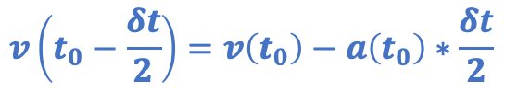
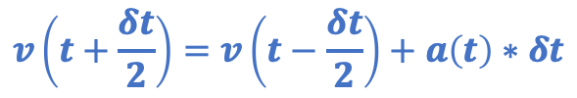
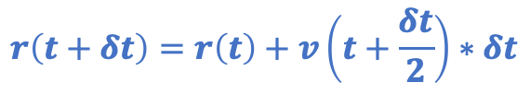
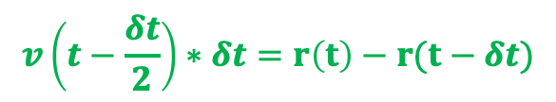
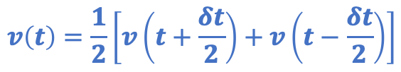
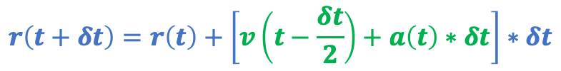
Integration Schemes: Leap-frog
Equivalent to Verlet scheme
$$v\left(t+\frac{δt}{2}\right)=v\left(t−\frac{δt}{2}\right)+a\left(t\right)∗δt$$
$$r\left(t+δt\right)=r\left(t\right)+\left[v\left(t−\frac{δt}{2}\right)+a\left(t\right)∗δt\right]∗δt$$
$$r\left(t+δt\right)=r\left(t\right)+v\left(t+\frac{δt}{2}\right)∗δt$$
$$v\left(t−\frac{δt}{2}\right)∗δt=r\left(t\right)−r(t−δt)$$
Current velocity
$$r\left(t+δt\right)=2∗r\left(t\right)−r\left(t−δt\right)+a(t)∗{\left(δt\right)}^{2}$$
$$v\left(t\right)=\frac{1}{2}\left[v\left(t+\frac{δt}{2}\right)+v\left(t−\frac{δt}{2}\right)\right]$$
To start the algorithm
No addition of small ($O{\left(δt\right)}^{2}$) and large ($O{\left(δt\right)}^{0}$) numbers
$$v\left(t_{0}−\frac{δt}{2}\right)=v\left(t_{0}\right)−a\left(t_{0}\right)∗\frac{δt}{2}$$
Position and velocity are not calculated in the same step

Slide 16
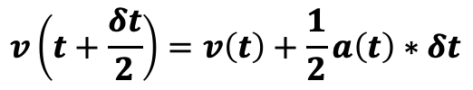
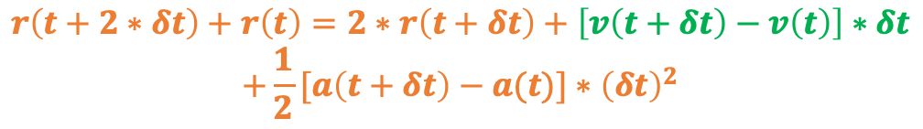
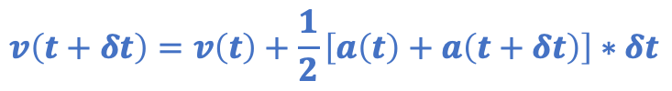
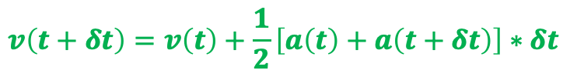
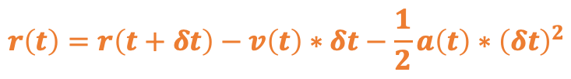
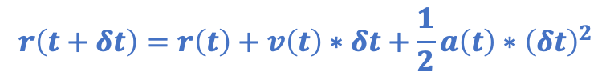
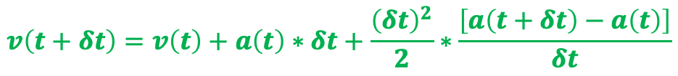
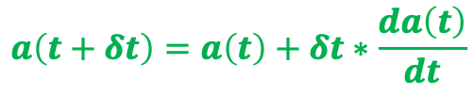
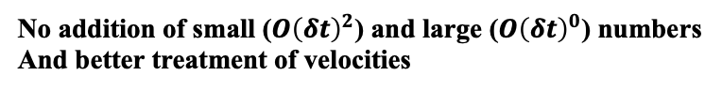
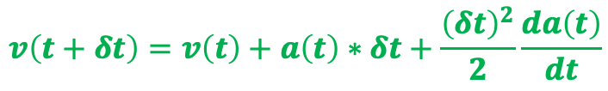
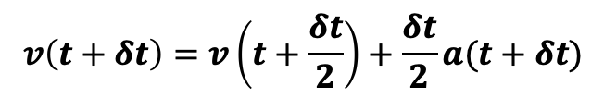
Integration Schemes: Velocity-Verlet
$$r\left(t+δt\right)=r\left(t\right)+v\left(t\right)∗δt+\frac{1}{2}a\left(t\right)∗{\left(δt\right)}^{2}$$
$$r\left(t+2∗δt\right)=r\left(t+δt\right)+v\left(t+δt\right)∗δt+\frac{1}{2}a\left(t+δt\right)∗{\left(δt\right)}^{2}$$
$$v\left(t+δt\right)=v\left(t\right)+\frac{1}{2}\left[a\left(t\right)+a\left(t+δt\right)\right]∗δt$$
$$r\left(t\right)=r\left(t+δt\right)−v\left(t\right)∗δt−\frac{1}{2}a\left(t\right)∗{\left(δt\right)}^{2}$$
$$v\left(t+\frac{δt}{2}\right)=v\left(t\right)+\frac{1}{2}a\left(t\right)∗δt$$
$$r\left(t+2∗δt\right)+r\left(t\right)=2∗r\left(t+δt\right)+\left[v\left(t+δt\right)−v\left(t\right)\right]∗δt$$
$$+\frac{1}{2}[a\left(t+δt\right)−a(t)]∗{\left(δt\right)}^{2}$$
$$v\left(t+δt\right)=v\left(t+\frac{δt}{2}\right)+\frac{δt}{2}a(t+δt)$$
$$r\left(t+2∗δt\right)+r\left(t\right)=2∗r\left(t+δt\right)+a\left(t+δt\right)∗{\left(δt\right)}^{2}$$
$$v\left(t+δt\right)=v\left(t\right)+a\left(t\right)∗δt+\frac{{\left(δt\right)}^{2}}{2}\frac{da\left(t\right)}{dt}$$
Verlet Scheme
$$a\left(t+δt\right)=a\left(t\right)+δt∗\frac{da\left(t\right)}{dt}$$
$$v\left(t+δt\right)=v\left(t\right)+a\left(t\right)∗δt+\frac{{\left(δt\right)}^{2}}{2}∗\frac{\left[a\left(t+δt\right)−a\left(t\right)\right]}{δt}$$
$$v\left(t+δt\right)=v\left(t\right)+\frac{1}{2}\left[a\left(t\right)+a\left(t+δt\right)\right]∗δt$$
No addition of small ($O{\left(δt\right)}^{2}$) and large ($O{\left(δt\right)}^{0}$) numbers
And better treatment of velocities

Slide 17
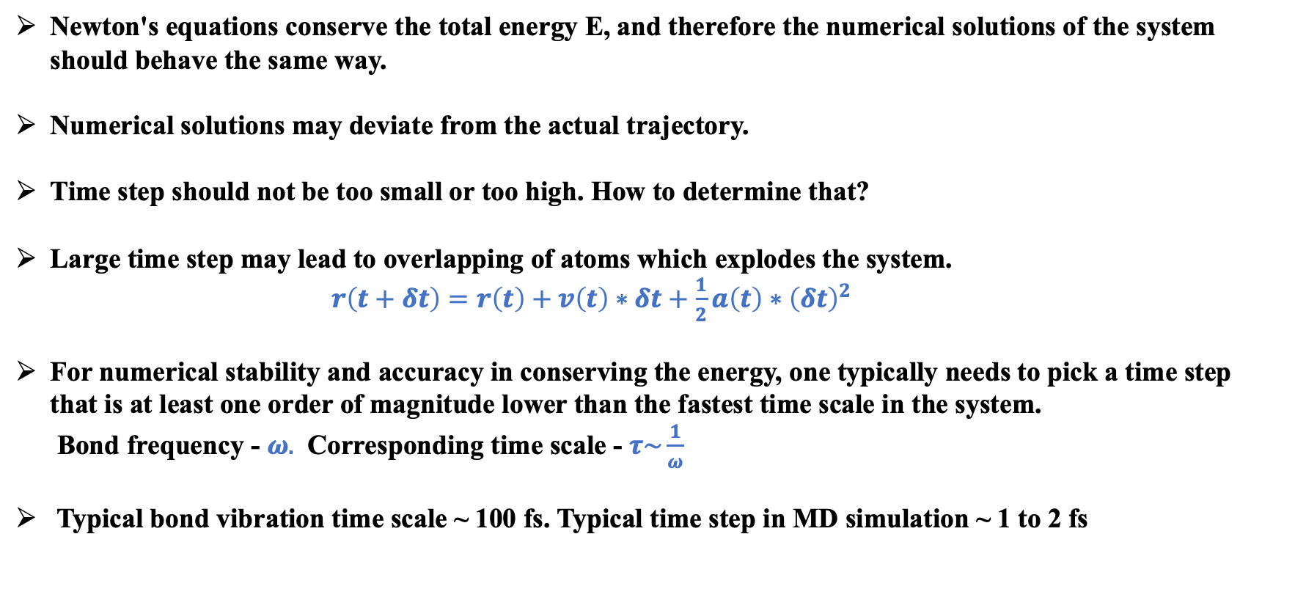
Time step
Newton's equations conserve the total energy E, and therefore the numerical solutions of the system should behave the same way.
Numerical solutions may deviate from the actual trajectory.
Time step should not be too small or too high. How to determine that?
Large time step may lead to overlapping of atoms which explodes the system. $r\left(t+δt\right)=r\left(t\right)+v\left(t\right)∗δt+\frac{1}{2}a\left(t\right)∗{\left(δt\right)}^{2}$
For numerical stability and accuracy in conserving the energy, one typically needs to pick a time step that is at least one order of magnitude lower than the fastest time scale in the system.
Bond frequency - $ω.$ Corresponding time scale - $τ\sim \frac{1}{ω}$
Typical bond vibration time scale ~ 100 fs. Typical time step in MD simulation ~ 1 to 2 fs

Slide 18
Time step
Figure Courtesy: Matthieu Micoulaut

Slide 19
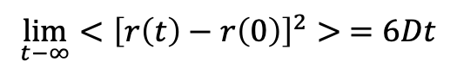






Physical Quantities
State Variables: Measurable properties of a system
State Functions: Internal energy, Enthalpy, Entropy…
Conjugate Variables: [Temperature (T), Energy (E)]; [Pressure (P),Volume (v)]; [No. of atoms (N), Chemical potential ($μ$)]
One from each pair should be fixed to specify a thermodynamic system
Thermodynamic variables, structural and dynamical properties
$$<\frac{1}{2}mv_{α}^{2}>=\frac{1}{2}k_{B}T$$
$$g\left(r\right)−RDF$$
$$\lim_{t−∞}{<{\left[r\left(t\right)−r\left(0\right)\right]}^{2}> =6Dt}$$
$$P=ρk_{B}T+\frac{1}{dV}<\sum_{i<j}{f\left(r_{ij}\right).r_{ij}}>$$
$$T(t)=\sum_{i}{\frac{m_{i}v_{αi}^{2}\left(t\right)}{k_{B}N}}$$
$$γ=\int_{0}^{∞}{<{\dot{A}\left(t\right)}^{ }\dot{A}\left(t\right)>dt }$$
$$<E^{2}> − <E>^{2}=\frac{3k_{B}^{2}T^{2}}{2N}\left(1−\frac{3k_{B}}{2C_{V}}\right)$$
Entropy (S), Helmholtz free energy (F), Gibbs free energy (G) can not be directly calculated
Static equilibrium properties – can be calculated from both MD and MC
Dynamics equilibrium properties such as diffusion coefficient,
correlation functions can be calculated from MD only

Slide 20












Short Range and Long Range Interactions
Short Range
Shifted Potential
Long Range
$$U_{s}\left(r\right)=U\left(r\right)−U\left(r_{c}\right); for r≤r_{c}$$
$$\int_{r_{c}}^{∞}{\frac{1}{r}∗4πr^{2}∗dr=∞}$$
$$U_{s}\left(r\right)=0; for r>r_{c}$$
Shifted Force Potential
$$u\left(r\right)=u_{sr}\left(r\right)+u_{lr}(r)$$
$$U_{sf}\left(r\right)=U\left(r\right)−U\left(r_{c}\right) −{\left[\frac{du\left(r\right)}{dr}\right]}_{r=r_{c}}\left(r−r_{c}\right); for r≤r_{c}$$
$u_{sr}$ is calculated in real space through direct sum
within a certain cut-off.
$$U_{sf}\left(r\right)=0;for r>r_{c}$$
$u_{lr}$ is the contribution from the region beyond the
cut-off, which is calculated in momentum space.
Switching Function
$$U_{sw}\left(r\right)=u\left(r\right)∗S(r)$$
$$For details look at ′Ewald′ and$$
$$′Particle−mesh−Ewald′ method$$
$$S\left(r\right)=1.0; \frac{dS}{dr}=0; \frac{d^{2}s}{dr^{2}}=0 at r=r_{l}$$
$$S\left(r\right)=0; \frac{dS}{dr}=0; \frac{d^{2}s}{dr^{2}}=0 at r=r_{u}$$
Usually a cubic spline function is chosen as $S\left(r\right)$

Slide 21













Ensembles: Thermostat and Barostat
Constant energy ensemble (NVE) may not be realistic.
Need heat bath coupling.
Berendsen coupling:
J. Chem. Phys. 81, 3684 (1984)
Velocity rescaling
coupling strength can be controlled, can be achieved by adding a
friction and a stochastic term to the force.
$$T(t)=\sum_{i}{\frac{m_{i}v_{αi}^{2}\left(t\right)}{k_{B}N}}$$
$$v_{αi}→λ∗v_{αi}$$
$$m_{i}r_{i}^{′′}=F_{i}−mγ_{i}v_{i}+R_{i}(t)$$
$R(t)$ – Gaussian noise
$$R_{i}\left(t\right)R_{j}\left(t+δt\right)=2m_{i}γ_{i}k_{B}T_{0}δ\left(δt\right)δ_{ij}$$
$$T_{new}=\sum_{i}{\frac{m_{i}{λ^{2}v}_{αi}^{2}\left(t\right)}{k_{B}N}=λ^{2}∗T(t)}$$
$$\frac{dE_{k}}{dt}=\sum_{i}{v_{i}F_{i}+2γ(\frac{3N}{2}k_{B}T_{0}−E_{k})}$$
$$T_{new}−T\left(t\right)={(λ}^{2}−1)∗T(t)$$
$$\frac{dT}{dt}=2γ(T_{0}−T)$$
If $T_{new}$ has to be equal to $T$
$$λ={\left[1+\frac{δt}{τ_{T}}\left(\frac{T_{0}}{T}−1\right)\right]}^{\frac{1}{2}}$$
$$τ_{T}={\left(2γ\right)}^{−1}$$
$$λ=\sqrt{\frac{T}{T\left(t\right)}}$$
Multiply the velocity by the factor $λ$ at each step

Slide 22

Ensembles: Thermostat and Barostat
Anderson thermostat (Frenkel and Smit)
The coupling to heat bath is represented by stochastic impulsive force that act occasionally
on randomly selected particles.
$$P\left(t,v\right)=γ\exp{(−γt)}$$
Probability that the next collision will take place in the interval ($t :t+δt)$
Nose-Hoover thermostat: based on extended Lagrangian formulation introducing an extra variable

Slide 23












Ensembles: Thermostat and Barostat
Berendsen Pressure coupling
$$P=ρk_{B}T+\frac{1}{dV}<\sum_{i<j}{f\left(r_{ij}\right).r_{ij}}>$$
An extra term is added to the equation of motion so that the change in pressure is given by
$$\frac{dP}{dt}={(P}_{0}−P)/τ_{p}$$
$$P_{0} −target pressure$$
$$\frac{dx}{dt}=v+αx$$
$$\frac{dV}{dt}=3αV$$
and
$$μ=\left[1−\frac{βδt\left(P_{0}−P\right)}{3τ_{p}}\right]$$
$$\frac{dP}{dt}=−\frac{1}{βV}∗\frac{dV}{dt}=−\frac{3α}{β}$$
$$μ={\left[1−\frac{βδt\left(P_{0}−P\right)}{τ_{p}}\right]}^{\frac{1}{3}}$$
$$α=−β(P_{0}−P)/3τ_{p}$$
$$\frac{dx}{dt}=v−\frac{β\left(P_{0}−P\right)}{3τ_{p}}x=μx$$
$$x to μx$$
$$l to μl$$

Slide 24









Periodic Boundary Conditions
https://www.ucl.ac.uk/~ucfbasc/Theory/pbc-mi.html
Imagine a lattice made by the original simulation box
As an atom moves in the simulation box, its periodic images also move
If an atom leaves the simulation box, one of its images will move into the simulation box
While using a cut-off, minimum image convention should be considered
$$if \left(x_{i}<−L_{x}∗0.5\right)$$
$$if \left({dx}_{ij}<−L_{x}∗0.5\right)$$
$$x_{i}=x_{i}+L_{x}$$
$${dx}_{ij}=dx_{ij}+L_{x}$$
$$dx_{ji}=x_{j}−x_{i}$$
$$if \left(x_{i}>L∗0.5\right)$$
$$if \left({dx}_{ij}>L_{x}∗0.5\right)$$
$$x_{i}=x_{i}−L_{x}$$
$${dx}_{ij}=dx_{ij}−L_{x}$$

